Slide 1

Applications of Voronoi Diagrams in Statistics and Data Science
Robert Garrett
Dr. Thomas Fisher

Slide 2
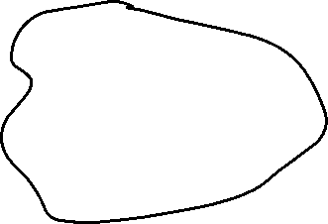
First, an activity!
Take out a piece of paper and a pencil/pen
Draw a rough “island” shape
Draw two points on your island: hospitals
What should the response regions be for each hospital?
Draw line between each site
Perpendicular bisector of this line creates Nearest Neighbor regions
Where would you place another hospital? Why?
What are the different components of this diagram?

Slide 3

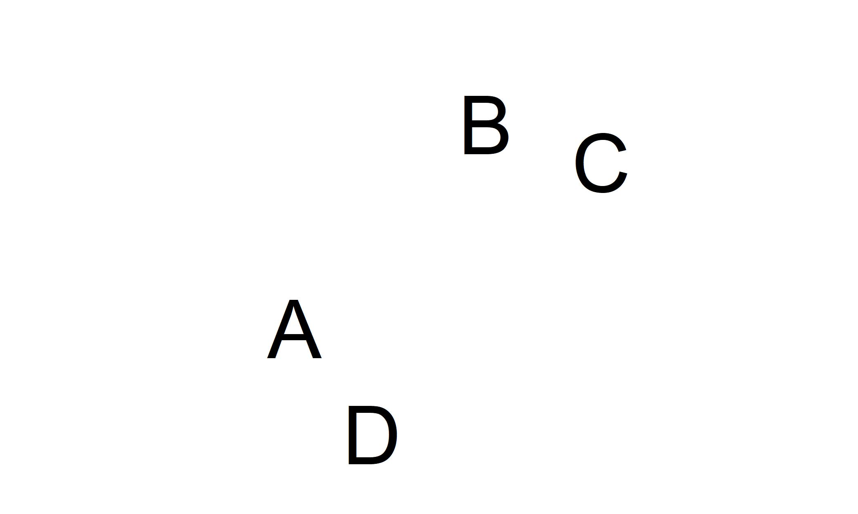
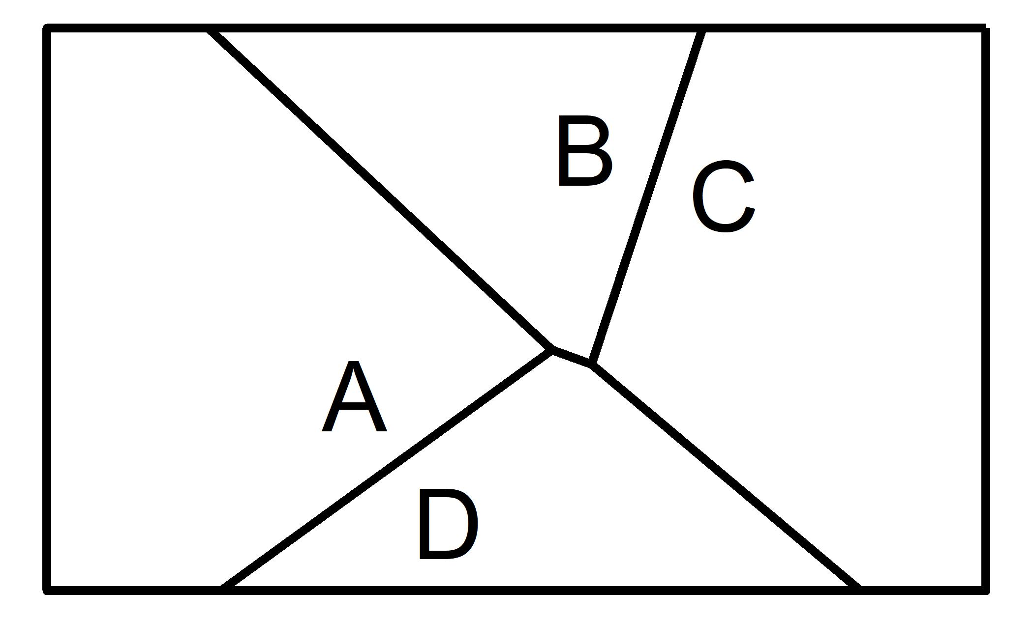
What is a Voronoi diagram?
Named after Georgy Voronoy, 1908
Nearest neighbor diagram
Take a set of generator points
Draw nearest neighbor cells
Points in a cell are closest to the cell’s generator

Slide 4
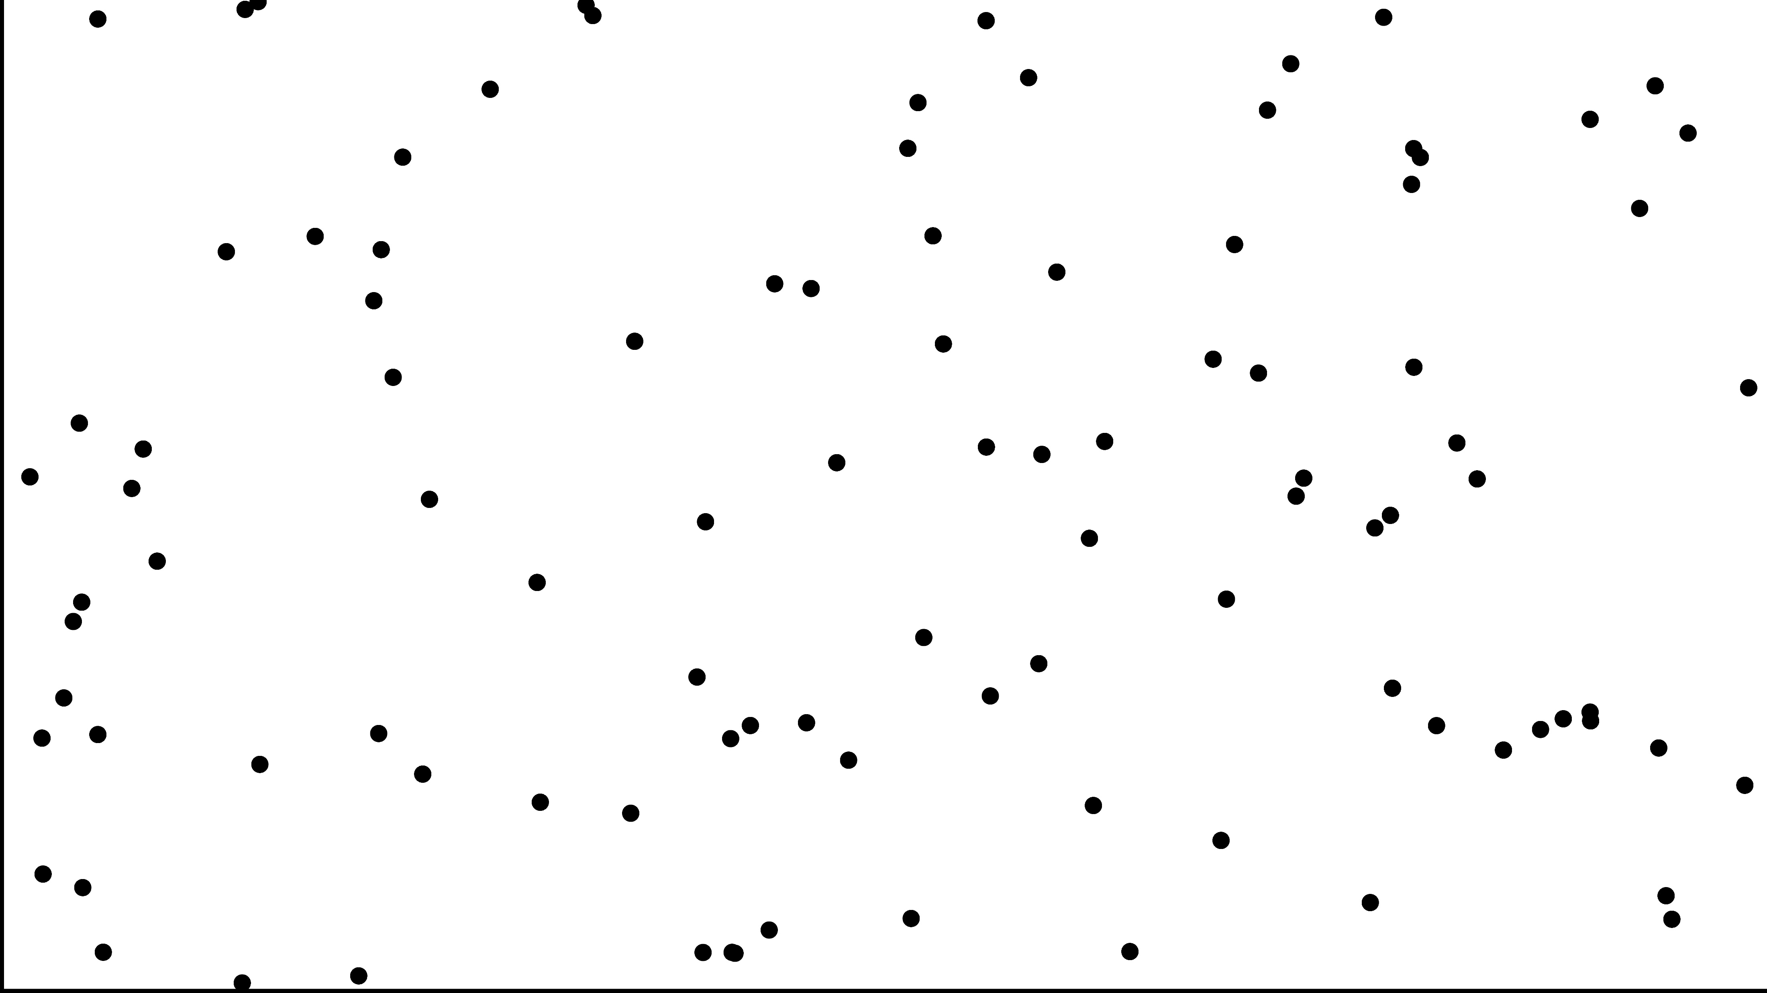

Slide 5
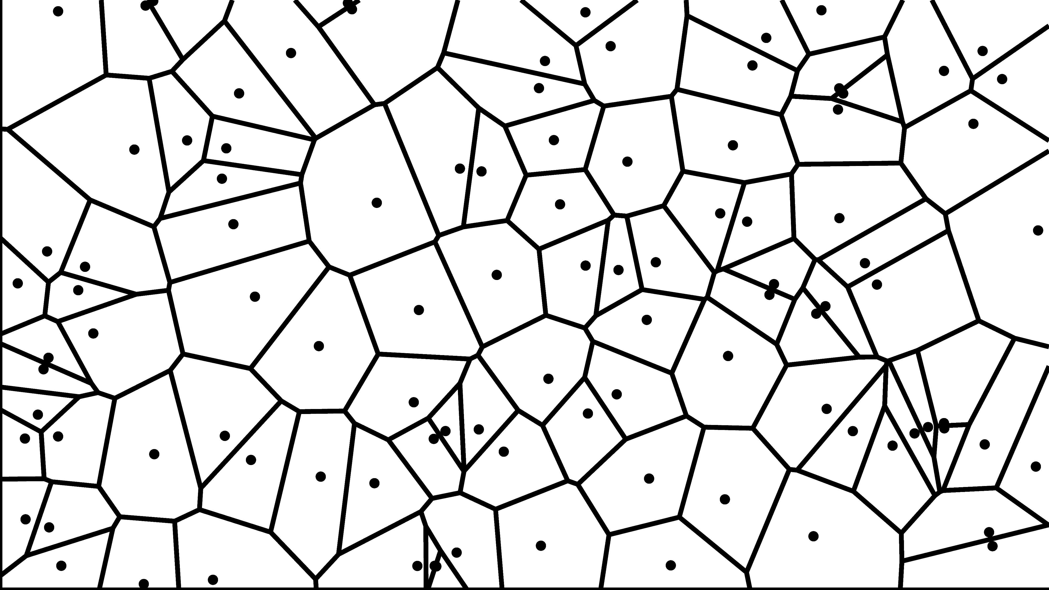

Slide 6
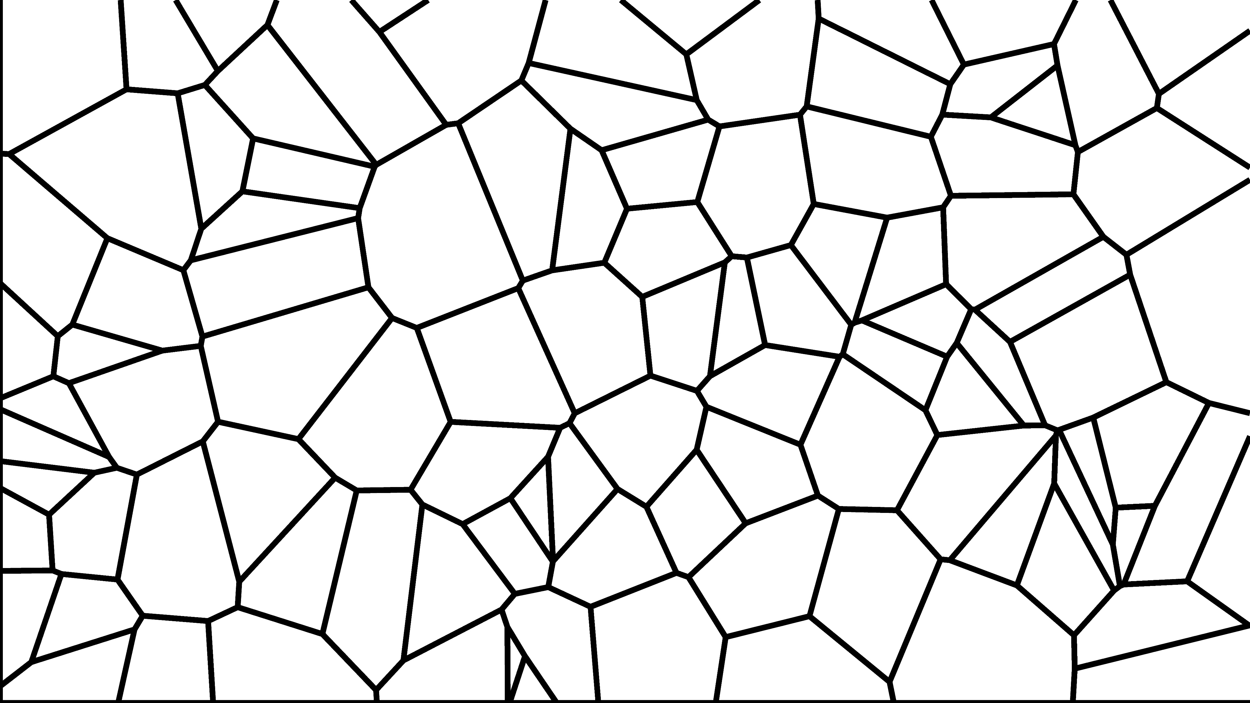

Slide 7
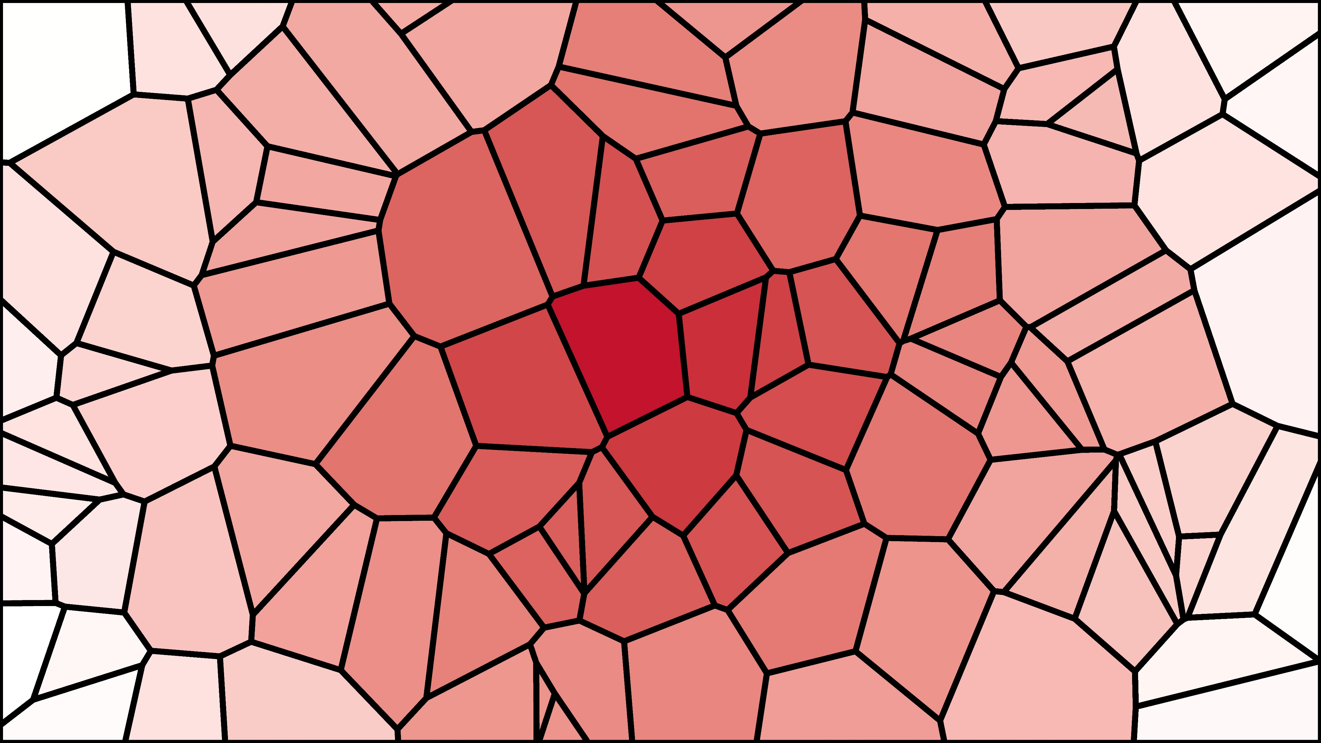

Slide 8


Slide 9
ggvoronoi
R package developed along with Austin Nar, Dr. Thomas Fisher, Dr. Karsten Maurer
Builds Voronoi diagrams using ‘deldir’, integrates with:
‘ggplot2’ for visualization
‘sp’ and ‘rgeos’ for spatial analysis
2 Dimensional diagrams based on euclidean distance
Optional 3rd variable allows for color fill
Specify a subset of the plane

Slide 10
Improving Navigation Software
When using navigation apps, often need a preliminary stop
In a car, I need a parking lot
Traveling by air, I need an airport
When boating, I need a dock
On my bicycle, I need a bike rack
Voronoi diagrams can provide an efficient solution
Draw Voronoi diagram of parking lots in the city
Which cell contains my destination?
Park at the corresponding generator lot
Using a Voronoi diagram over NN search provides visual insight

Slide 11
Bike racks in Oxford, Ohio
Location of each bike rack in Oxford, OH
Includes Miami University campus
Gathered by Madeline Maurer, Justin Hopkins, Dr. Helaine Alessio, Amanda Meiering
When navigating somewhere, want to find the closest bike rack
Plenty of open space: the town is very accessible by bike and by foot
Relatively straight path from bike rack to common destinations
Build Voronoi diagram of bike racks
Find closest bike rack to the destination
Navigate to destination via bike rack

Slide 12
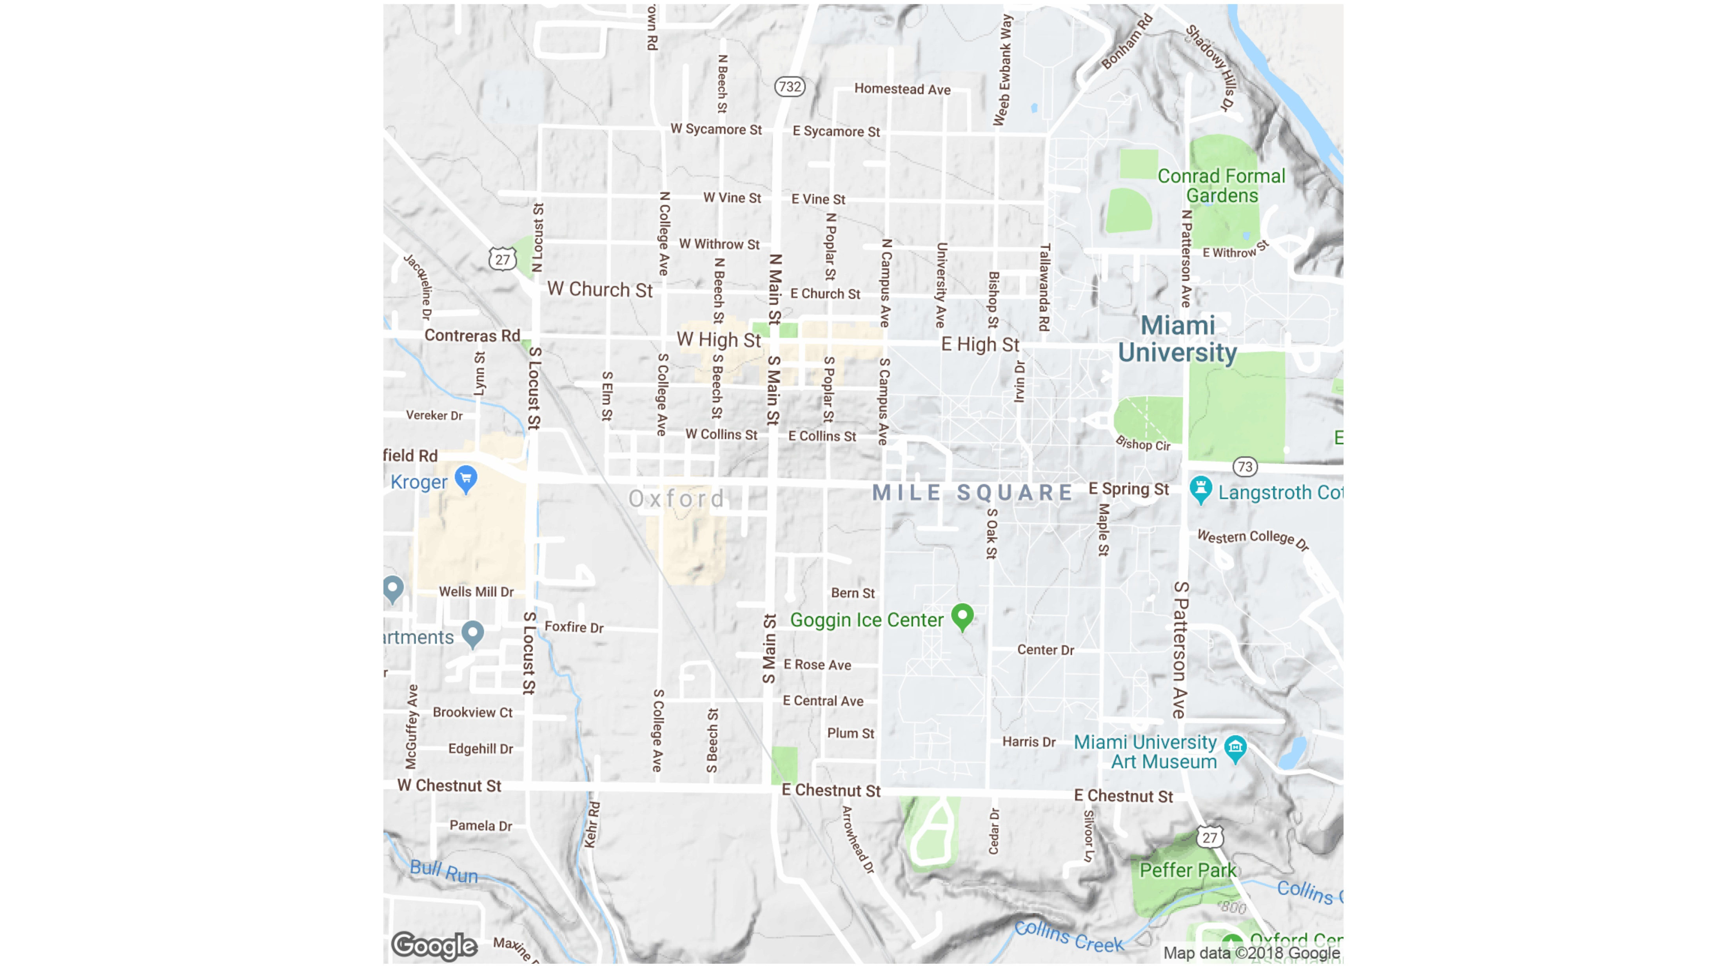
`

Slide 13
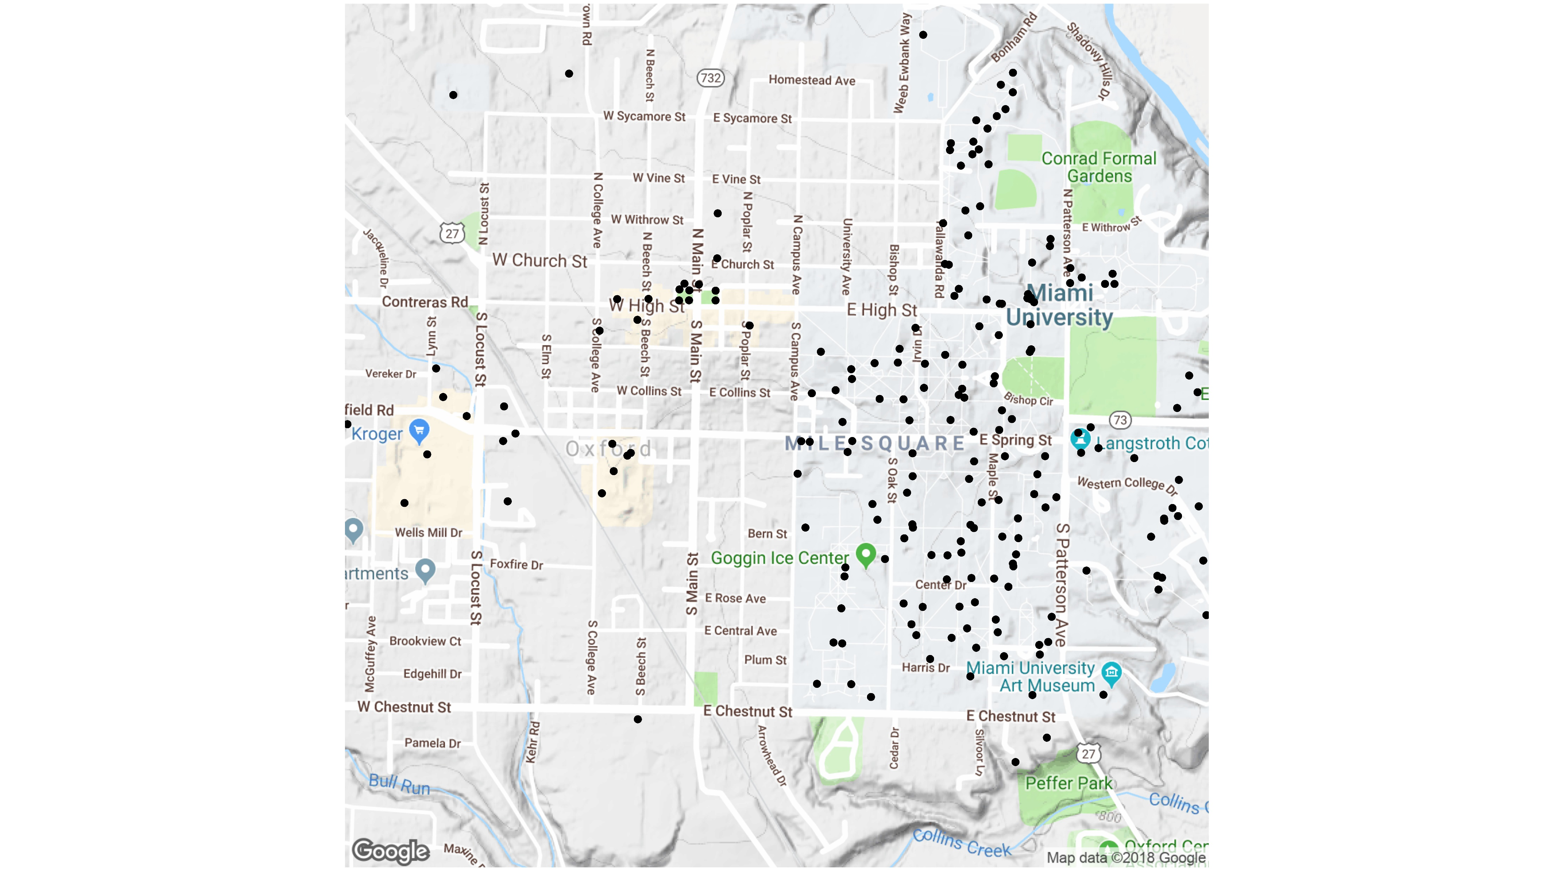

Slide 14
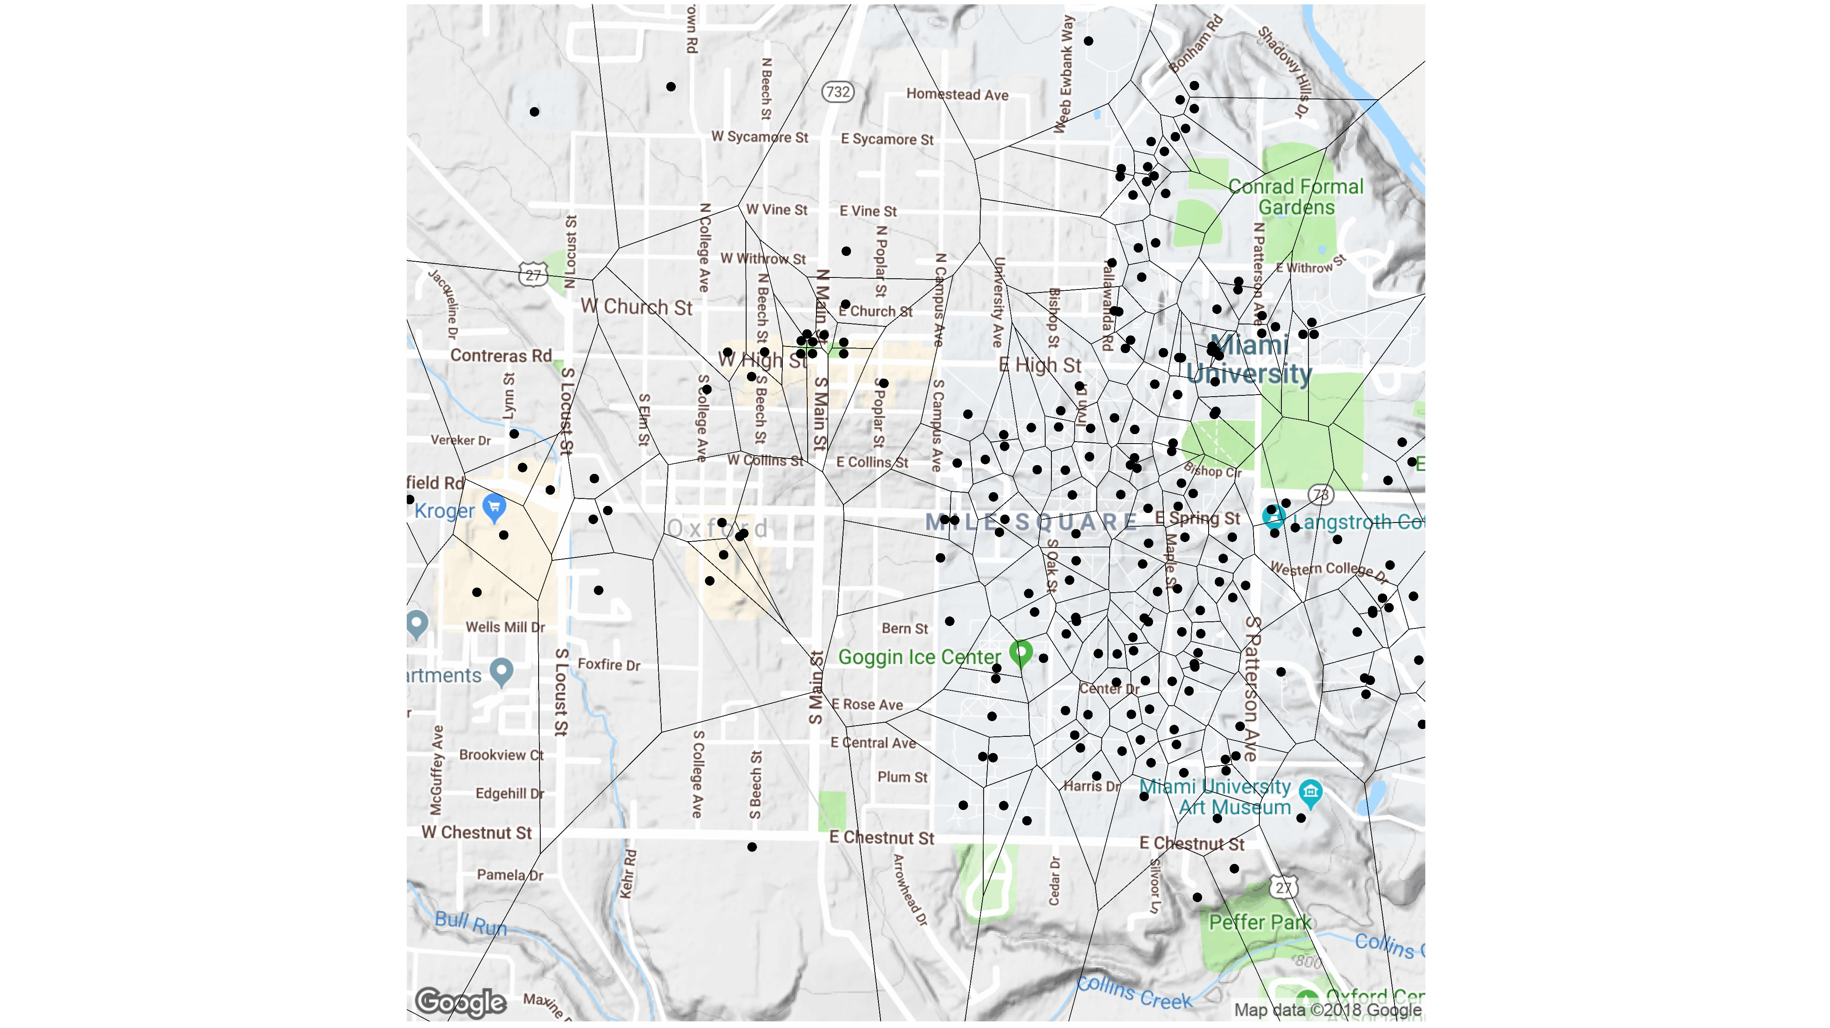

Slide 15
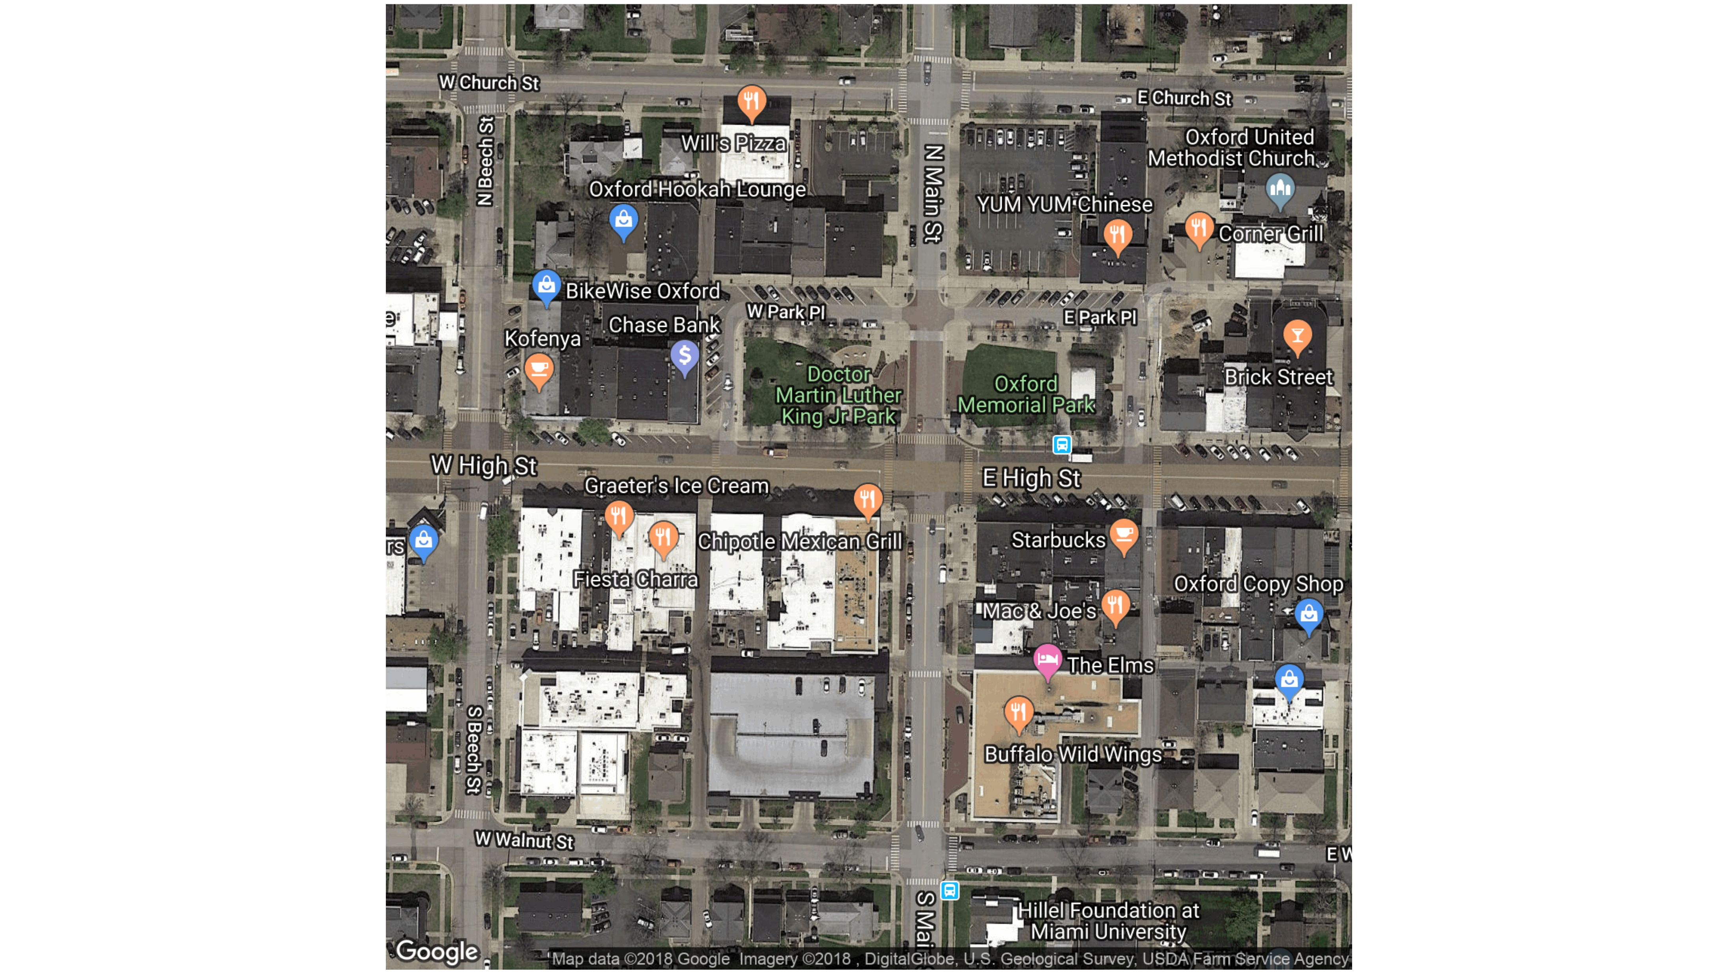

Slide 16
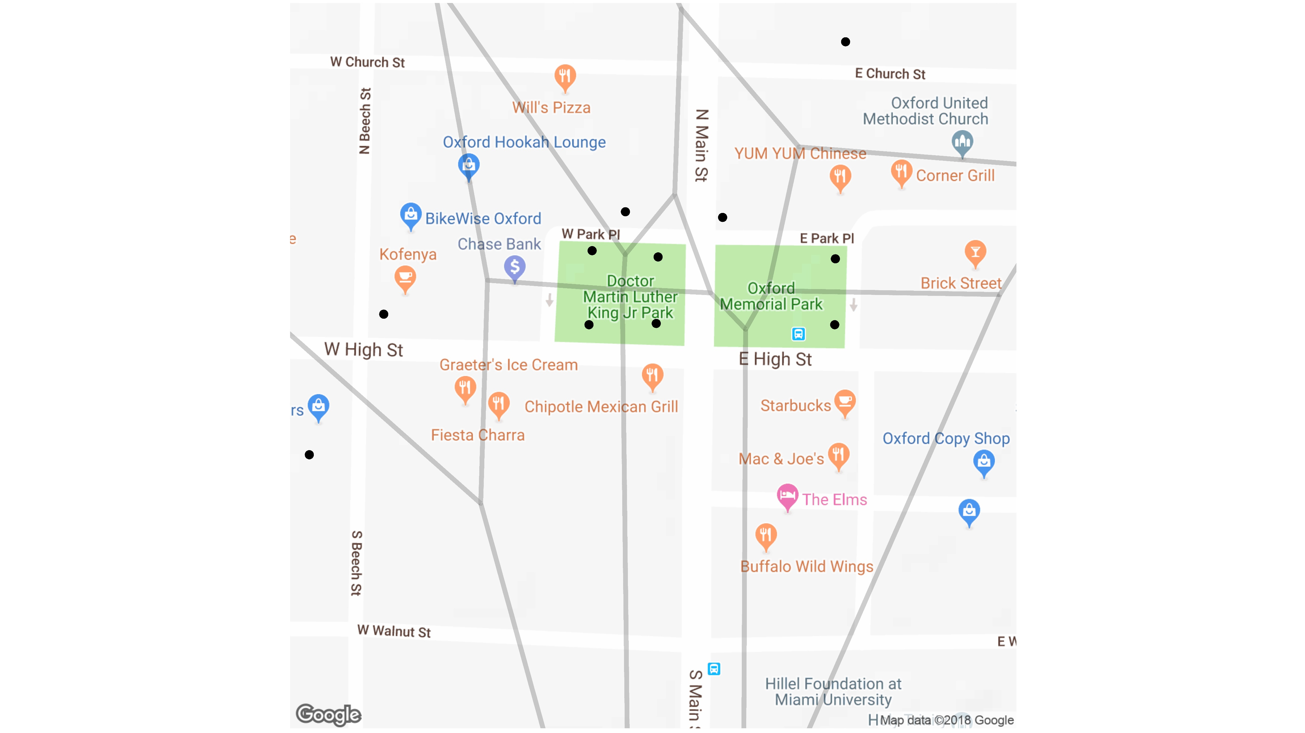

Slide 17
Applications in Data Visualization
Scatter plots:
Visualize every point
Can be too sparse or too dense to be useful
Choropleth Map:
Visual aggregates by region
Relies on predetermined boundaries (i.e. group by state)
Raster/Spatial Binning
Can be more “fair” than choropleth
Raster can’t be flexible for varying point densities
Voronoi diagrams can mitigate these issues

Slide 18
Elevation of North America
Location and elevation of 70,000 weather stations in North America
From National Climatic Data Center website: https://www.ncdc.noaa.gov/data-access/land-based-station-data
Cleaned version available in ggvoronoi package
Too many points for a colored scatter plot
If the points are too small, sparse areas aren’t visible
If the points are too big, dense areas overlap points
Solution: Voronoi diagram heatmap
Allows for varying point densities
Visual interpolation slows for smoother comparison

Slide 19
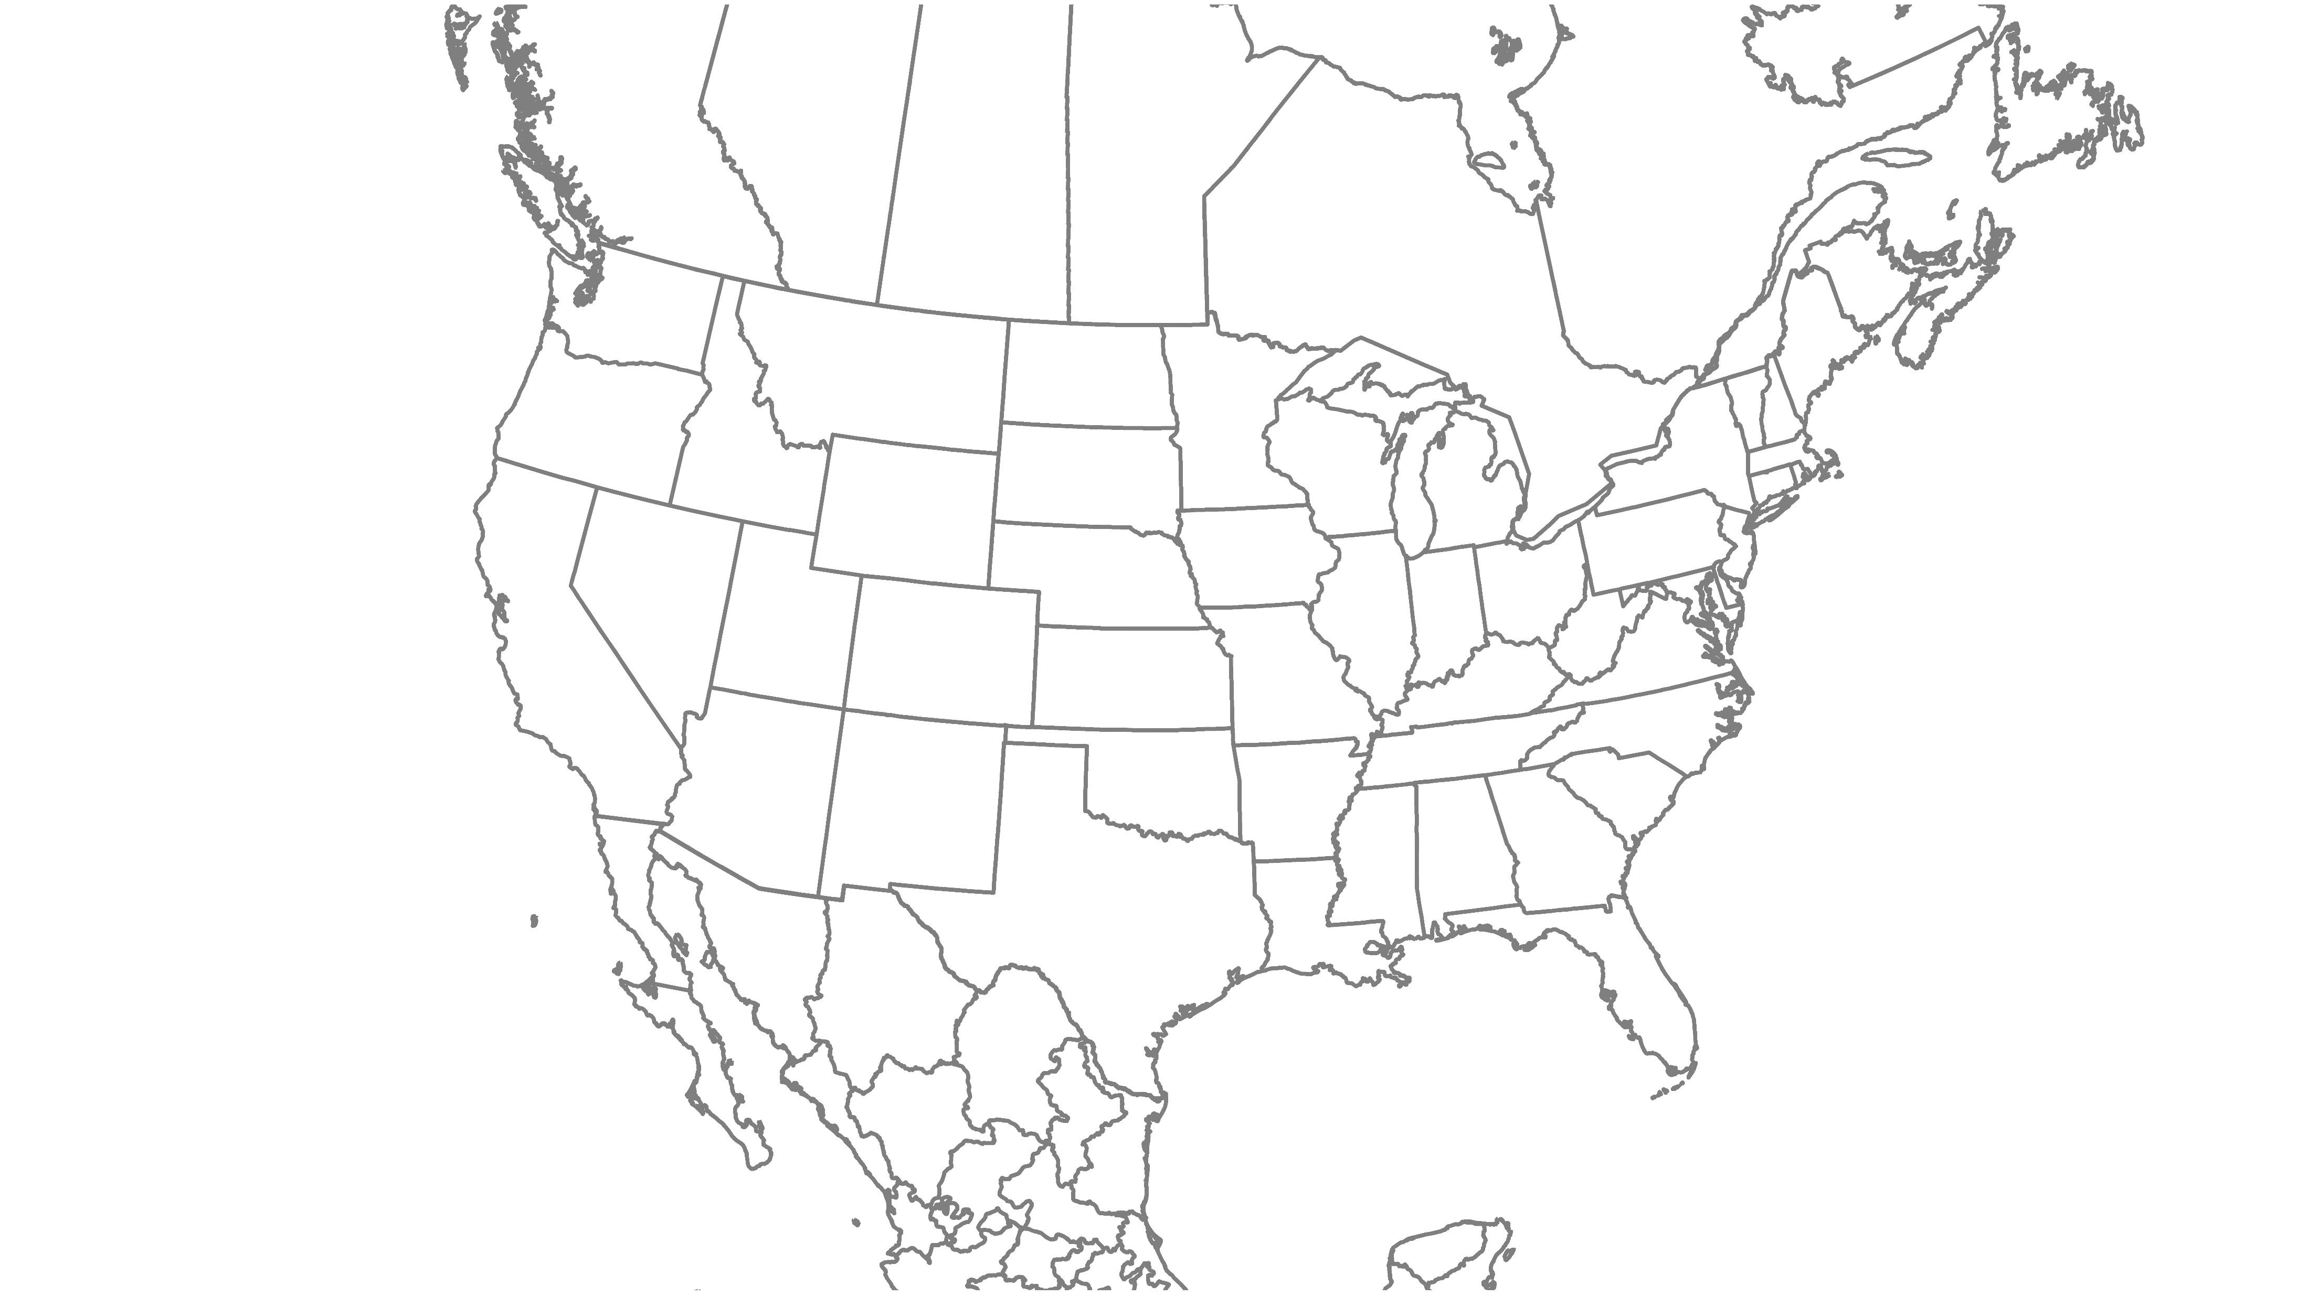

Slide 20
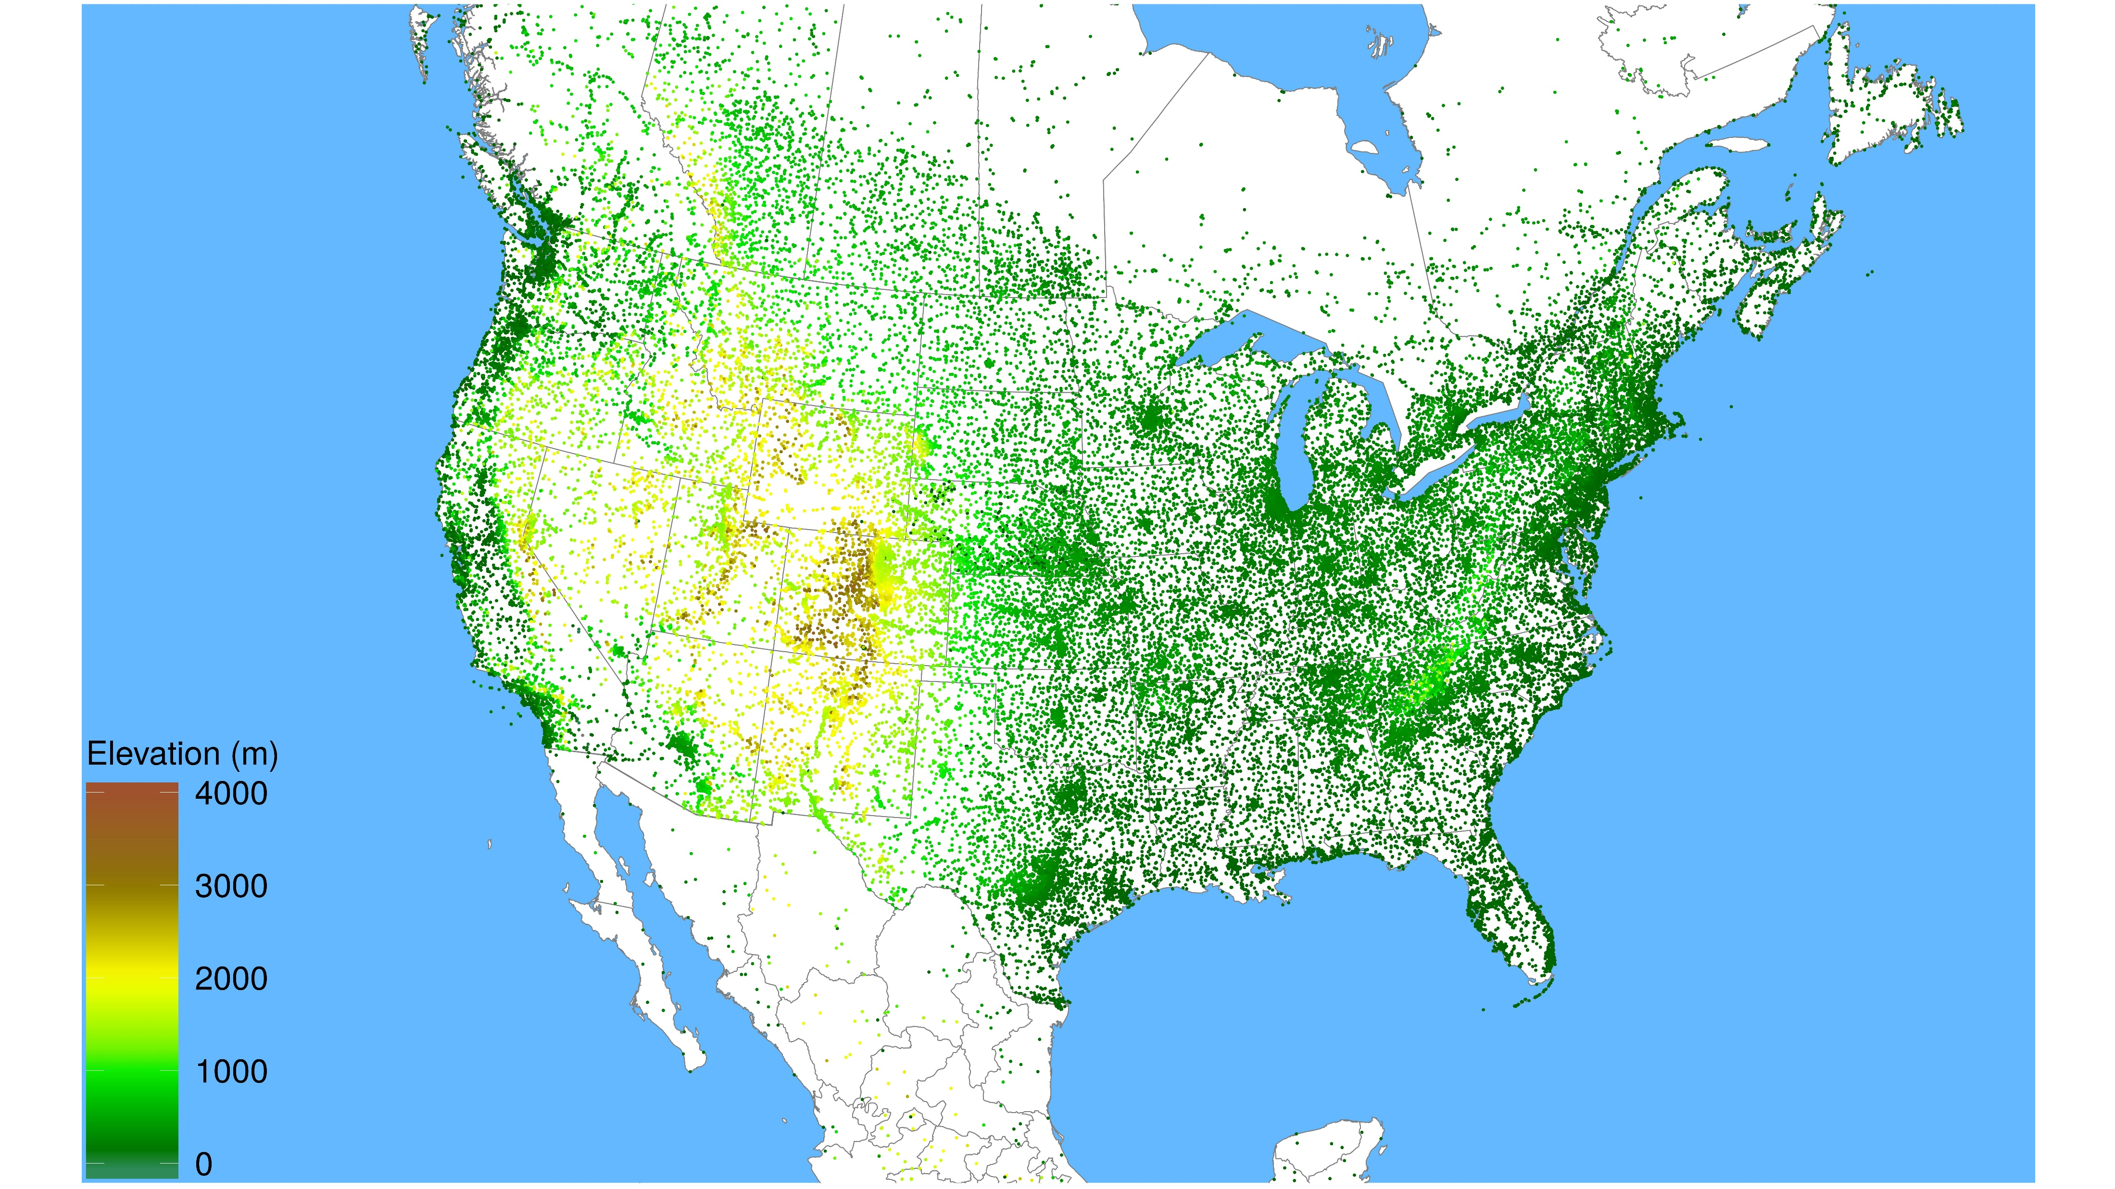

Slide 21
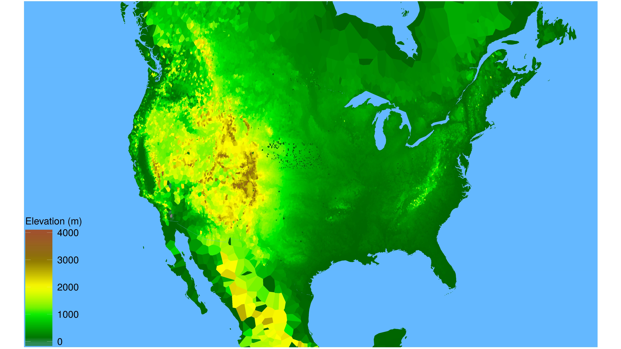

Slide 22
Future Work
Area based statistics
Basketball
Weighted interpolation for predictive models
Other distance metrics
Distance on a sphere
Manhattan distance
Travel time distance
User supplied distance metric

Slide 23
Want to learn more?
Interactive Voronoi Diagram: https://bl.ocks.org/mbostock/4060366
ggvoronoi: https://github.com/garretrc/ggvoronoi
My contact: Robert Garrett, garretrc@miamioh.edu

